Slide 1
Commissions, Reporting, BoB Management
Broker Training
2021

Slide 2
Training Topics
01 — Get Paid Commissions
02 — Setting Up Payments
03 — Commissions 101
04 — BoB Management

Slide 3
Getting Started

Slide 4
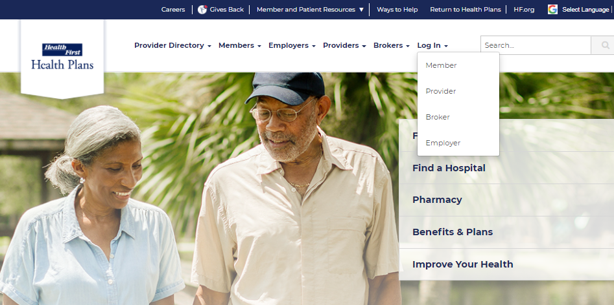
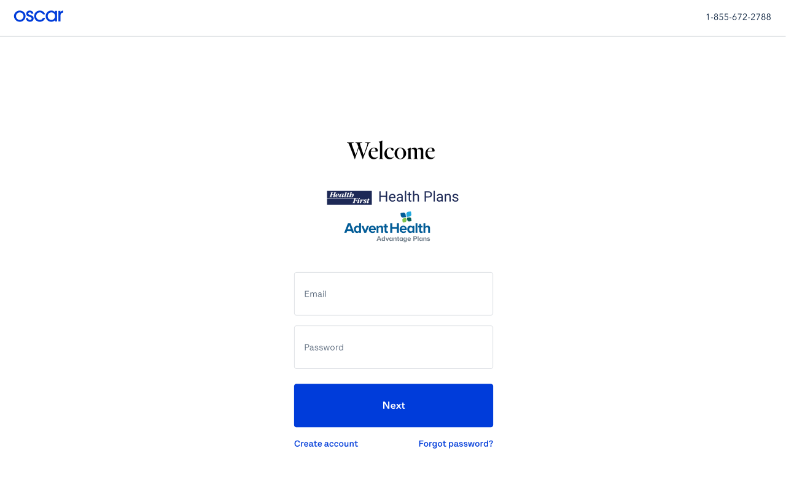
Getting Started – Log In
From the public website, locate the Broker Portal login page:
1. myHFHP.org or myAHPlan.com
2. Click “Login”
3. Click “Broker”
4. Log in
Note: Google Chrome is recommended

Slide 5
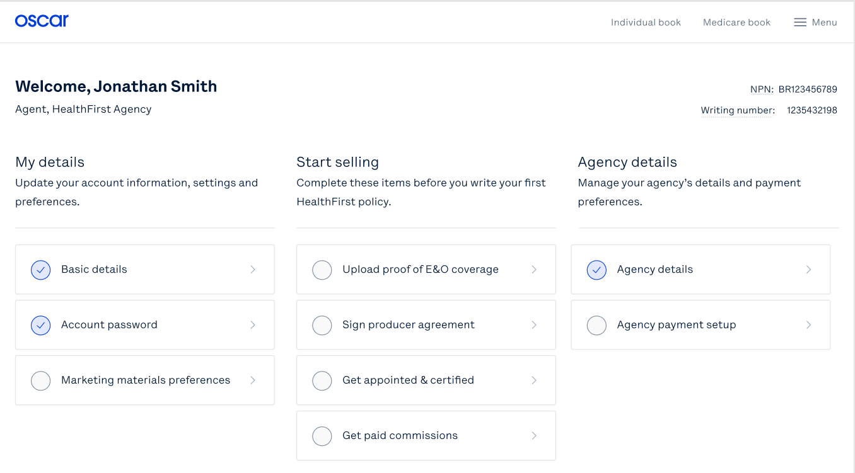
Broker Account:
Your Broker Account Homepage will allow you to view and update personal details, ready to sell documents, and agency details.
Agent, Health First Agency
Complete these items before you write your first Health First policy.

Slide 6
Broker Account: My details
The My details section will allow you to:
Update your personal details
Reset your password
Set marketing material preferences
Enter payment information
Agent, Health First Agency
1
Complete these items before you write your first Health First policy.

Slide 7
Setting Up Payments

Slide 8
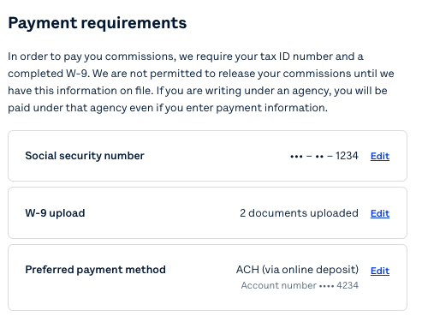
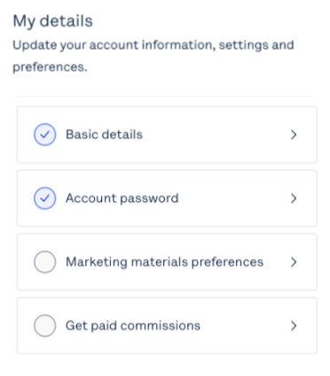
Broker Account: My details
Health First brokers will only have an ACH Direct Deposit payment method option
Get paid commissions will prompt you to enter your social security number, upload your W-9, and include your preferred payment method

Slide 9
Commissions 101

Slide 10
Commissions 101:
Remittance
Individual and Family Plan Remittance will occur ~15th of each month. ACH deposits will take 2-3 business days
Medicare Advantage Plan Remittance will occur ~26th of each month. ACH deposits will take 2-3 business days
Statements will be generated monthly, and disbursed within 2 days of commissions being paid
Individual and Family Plan Statements will be available within the broker portal
Medicare Advantage Statements will be emailed to the address on file, and will be available in the broker portal
Brokers may export their commission statements via their broker portal
Need support? Reach out to hf-brokercommissions@plusoscar.com

Slide 11
Commissions Management:
Agent, Health First Agency
Complete these items before you write your first Health First policy.
From the Menu, select Commissions in order to view reporting and view & download statements

Slide 12
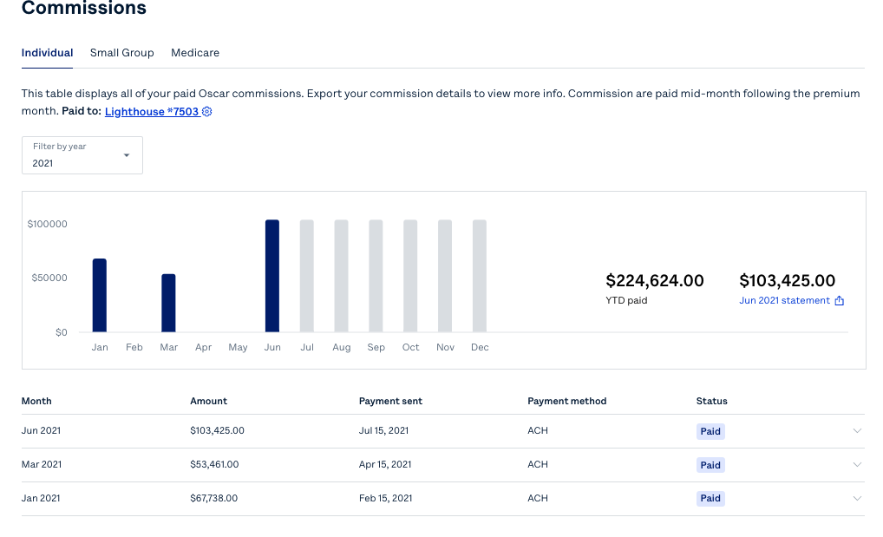
Commissions Management: IFP
Select your Line of Business
Toggle between years
View Month by Month Commissions Changes
Look at YTD Payments
View & download monthly statements
1
This table displays all of your Health First commissions. Export your commission details to view more info. Commissions are paid mid-month following the premium month. Paid to: [Account Name]
2
4
3
5

Slide 13
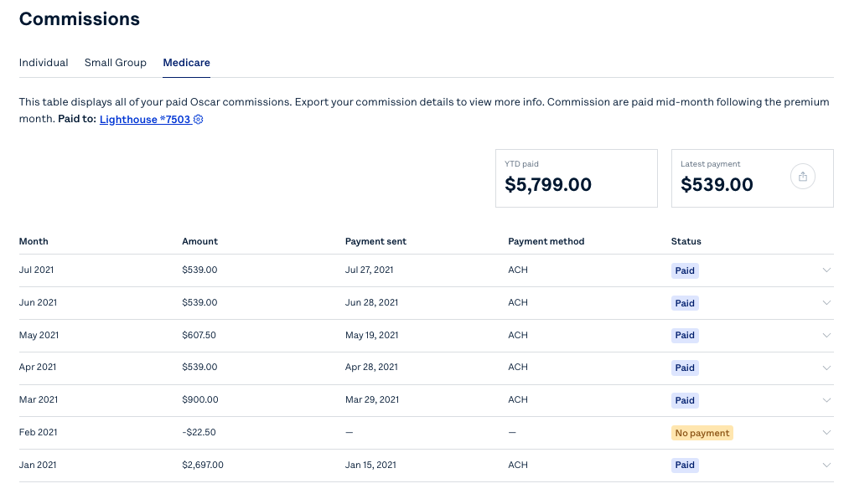
Commissions Management: MA
Select your Line of Business
Look at YTD Payments
View & download monthly statements
1
This table displays all of your Health First commissions. Export your commission details to view more info. Commissions are paid mid-month following the premium month. Paid to: [Account Name]
2
3

Slide 14
BoB Management

Slide 15
Locating your BoB
To view your Book of Business, select either Individual book or Medicare book via the top navigation bar of the broker portal
Agent, Health First Agency
Complete these items before you write your first Health First policy.

Slide 16
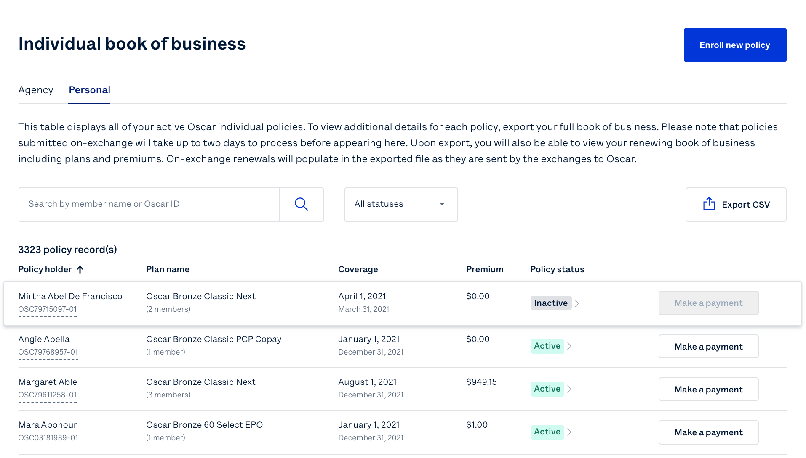
Managing your BoB
Quote & enroll clients in minutes
Search by name, or filter by status to find clients
Click on any client to view more details including plan information, dependents, contact information, billing & payment history
Export your BoB to see more details
Make a payment on behalf of your members
For agency principals: View and manage any policies attributed to your agency
1
1
6
This table displays all of your active Health First individual policies. To view additional details for each policy, export your full book of business. Please note that policies submitted on-exchange will take up to two days to process before appearing here.
This table displays all of your active Health First individual policies. To view additional details for each policy, export your full book of business. Please note that policies submitted on-exchange will take up to two days to process before appearing here. Upon export, you will also be able to view your renewing book of business including plans and premiums.
2
4
4
3
Joe Smith
OSC00000000-00
5
Jane Doe
OSC00000000-00
5
John James
OSC00000000-00
These functionalities will also be available for Medicare Advantage BoB as well
For demonstration purposes ONLY, Oscar sample data is shown above

Slide 17
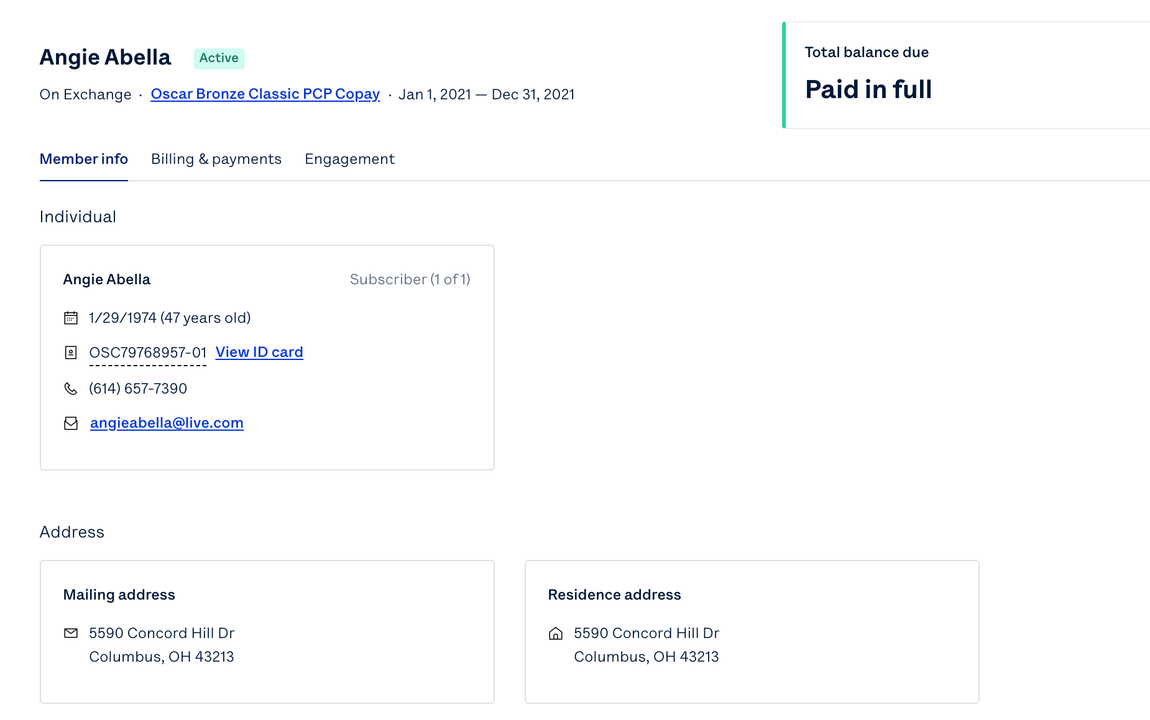
Managing Your Members’ Information
Check to see if your member is up to date on their premium balance
Select to review member information
Review member information
Select to view their Digital ID Card
Jane Doe
1
2
3
Jane Doe
X/X/XXX (XX years old)
4
OSC00000
(XXX) XXX-XXXX
janedoe@gmail.com
These functionalities will also be available for Medicare Advantage BoB as well
123 River Drive
New York, NY 10013
123 River Drive
New York, NY 10013
For demonstration purposes ONLY, Oscar sample data is shown above

Slide 18
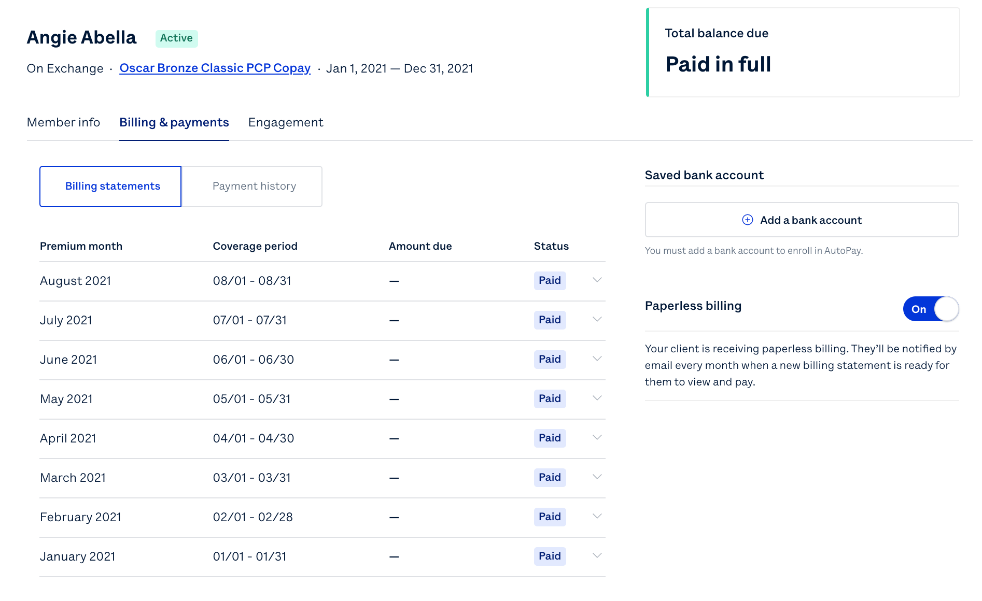
Managing your Member’s Billing Statements
Select to review billing & payment information
Select to review billing statements
Review billing statements & status
Add a bank account
Turn on Paperless billing
Review payment information & monthly bill
Jane Doe
11
2
4
3
5
6
For demonstration purposes ONLY, Oscar sample data is shown above

Slide 19
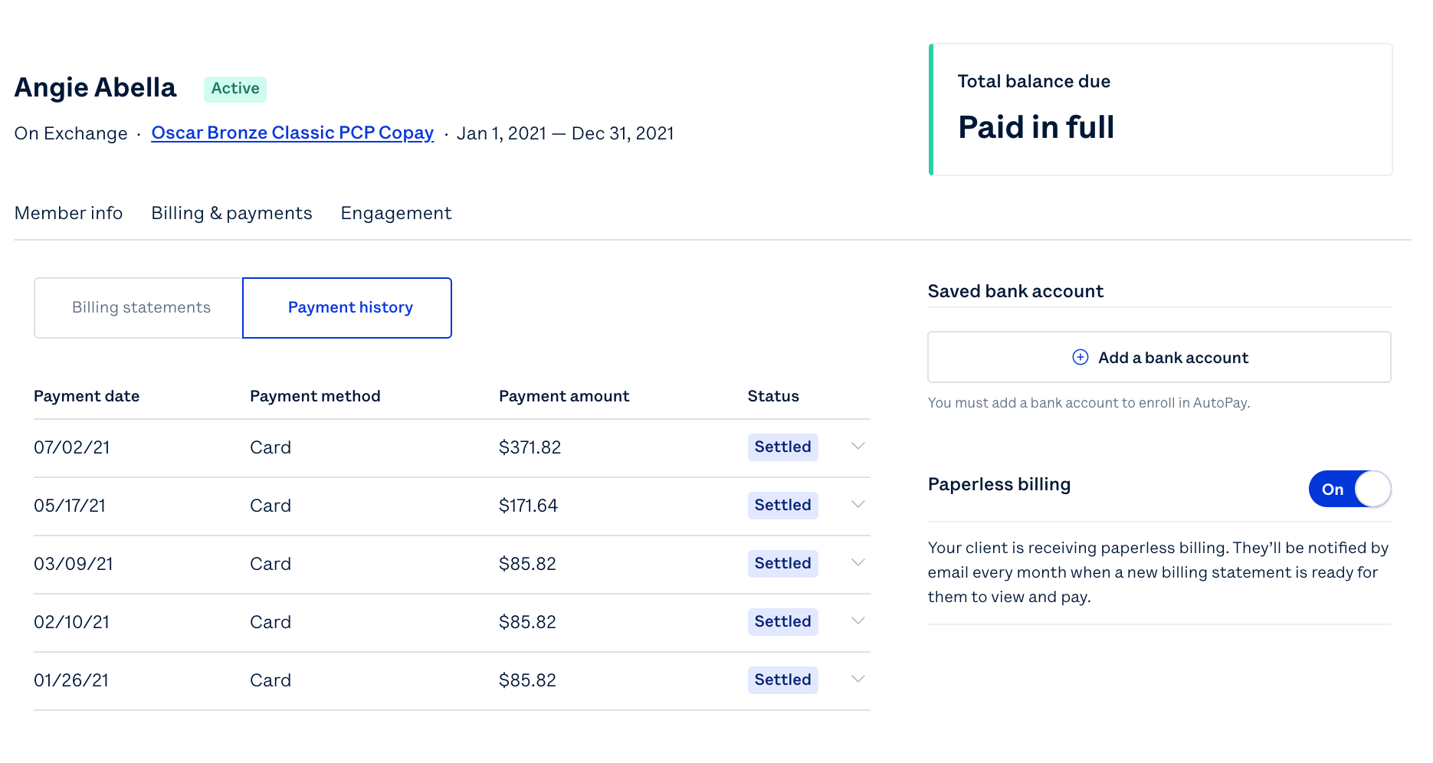
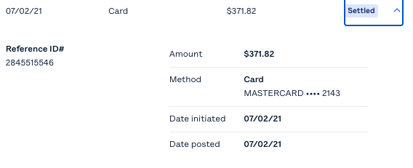
Managing your Member’s Payment History
Select to review payment history
Review payment history and status
Review payment amount, date, and method of payment
Jane Doe
Jane Doe
11
2
3
For demonstration purposes ONLY, Oscar sample data is shown above

Slide 20
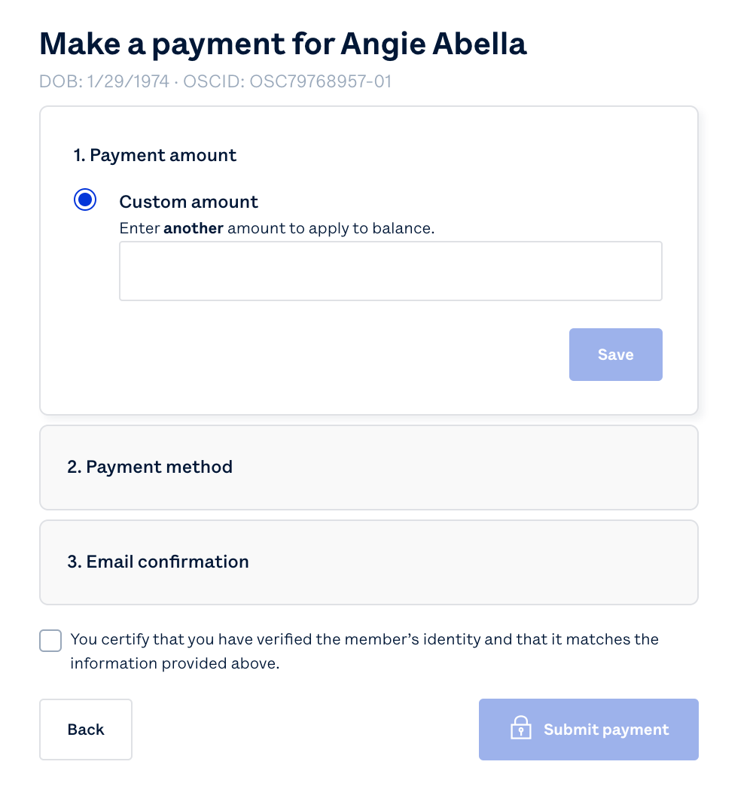
Managing your Member’s Payments
Make a payment for Jane Doe
DOB: X/X/XXX OSCID: OSC0000000-00
Joe Smith
OSC00000000-00
Jane Doe
OSC00000000-00
John James
OSC00000000-00
Select make a payment, with the members banking/payment information, then enter the payment amount and method on behalf of your client
For demonstration purposes ONLY, Oscar sample data is shown above

Slide 21
Oscar’s Broker Support Team is here to help
✓ Broker account support
✓ Appointment & certification support
✓ Commissions escalations
✓ Eligibility inquiries
✓ Member inquiries & support
✓ Network/Rx support
Monday through Friday 8:00am - 6:00pm EST
hf-brokers@plusoscar.com
hf-brokercommissions@plusoscar.com
877-693-6489

Slide 22
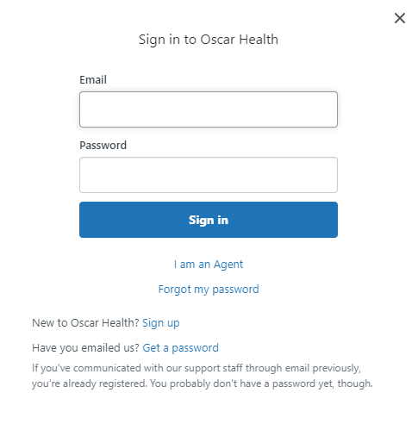
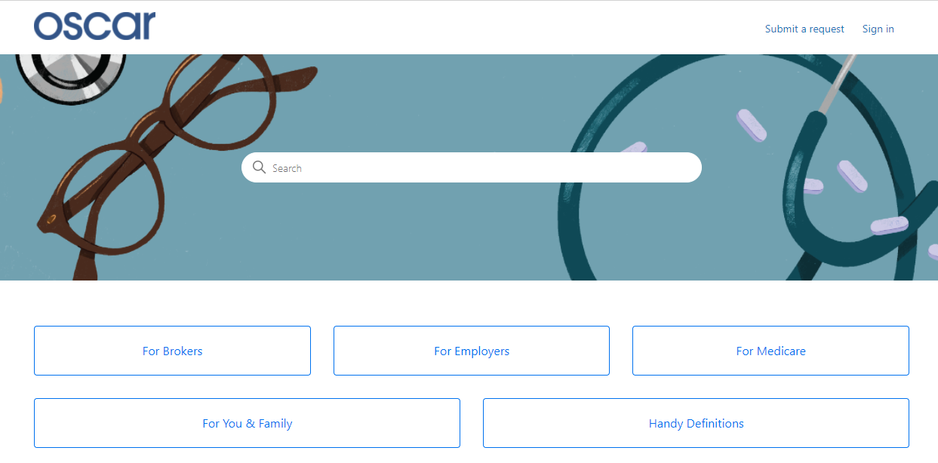
Creating Your Zendesk Account
In order for brokers to communicate with Oscar through the designated emails provided, you will need to create an account through Zendesk. Follow the below steps.
Start at Oscar’s Zendesk Help Center
Click "Sign in" from the top right
A pop-up window will prompt you to sign in. If you don’t have an account, select "Sign up" next to "New to Oscar Health?"
Submit your full name and email address
Click the blue "Sign up" button. Look for an email to complete account set-up.
From your inbox, look for "Welcome to Oscar Health." Click the link to complete creating your password.
You can now successfully communicate to/from, via email, with Oscar.

Slide 23
Health First Health Plans Broker Services is available: Monday through Friday 8:00 a.m. to 5:00 p.m.
For questions contact us at: 321.434.5265 or HFBroker@HF.org

